Slide 1
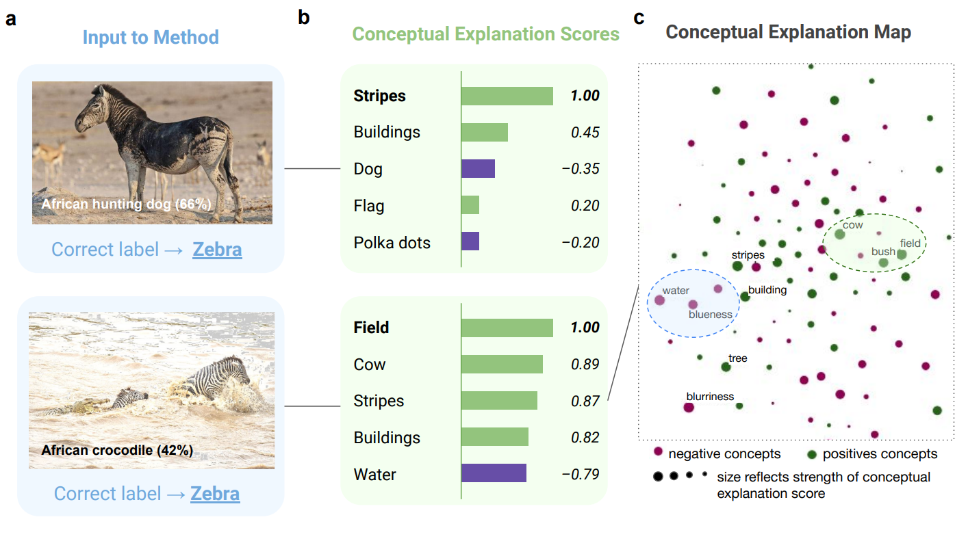


Machine learning models make mistakes. Can we explain why? Abubakar Abid and James Zou
Output of our method:
This zebra is misclassified as an African hunting dog because of the lack of stripes

